Slide 1

Data Analytics Strategy

Slide 2
Agenda
What are we doing
What we want to archieve
Next Step Questions
Wrap Up

Slide 3
What are we doing
It is hardly arguable, that we live in the age of exponential growth. Besides many other things, the growth of the data volume generated by us is rocketed too (e.g. according to researches of IDC mankind doubles the data generated in every 24 months), thereby the business value potential hidden in this data is also continuously growing. the basic goal of data strategy is to create and maintain an enterprise-wide strategy that ensures the adequate protection, quality, value, and utilisation of corporate data assets available through harnessing data-related and data-dependent capabilities. An effective data strategy (similarly to other corporate strategies) has the following properties:
• Actionable
• Relevant (contextual to the organisation, not generic)
• Evolutionary (needs continuous revisiting and update)
• Integrated / connected

Slide 4
What we want to archieve
Improving Business Decisions - In order to make good business decisions, we need to know better our customers, products, services, competitors and markets, monitor better financial and other internal processes, and effectively leverage human resources. Enterprise data assets can help to achieve these objectives.
Improving Your Operations - Manufacturing: monitoring equipment and machines for early identification of wear and tear, for intelligent planning and reduction of downtime (predictive maintenance), for reduction of defective products or for improvement of product quality. Warehousing and Distribution: automated warehouse; intelligent supply chain management; delivery route optimization. Business Process Improvement: fraud detection, data-driven risk estimation, automatic content generation with artificial intelligence
Sales and Marketing: churn / fading / attrition prediction, personalised offers and product recommendation systems, dynamic pricing, customer satisfaction prediction, channel optimization.
Data Monetisation Well-maintained data assets with appropriate quality can directly increase your company’s market value, but it is also possible to sell data assets to individuals and other companies.

Slide 5
Next steps questions
Available and potentially obtainable internal data sources, and accessible external databases (the goal is to identify the combination of data, that provides the highest business value during the exploiting of corporate data asset)
Data utilisation (in decision making; in business operations; in direct monetisation)
Technology and data infrastructure to be used (data collection, storing data analytics and data processing,access to data, visualisation and communication)
Building data competencies (building and developing internal skills and competencies; using external competencies)
Data governance (data ownership and privacy, integrity and security).

Slide 6
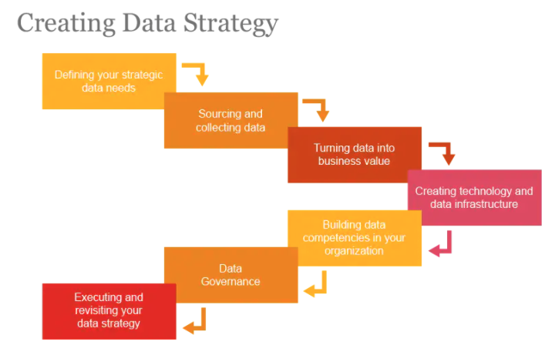
Wrap Up

